Slide 1

Shiny App Development
Ethan lang
Stat 824

Slide 2
Project Objective
The objective of this project is to create a tool that is easy to use and visually displays the differences in income between different demographics such as age, sex, marital status, etc.

Slide 3
Requirements
Give the users three visuals to view the data in different ways
Allow the users to choose the number of clusters when using a clustering method
Allow the users to choose between different variables
Add a dynamic data dictionary that updates when selecting different variables
The chosen visuals must be easy to understand and intuitive

Slide 4
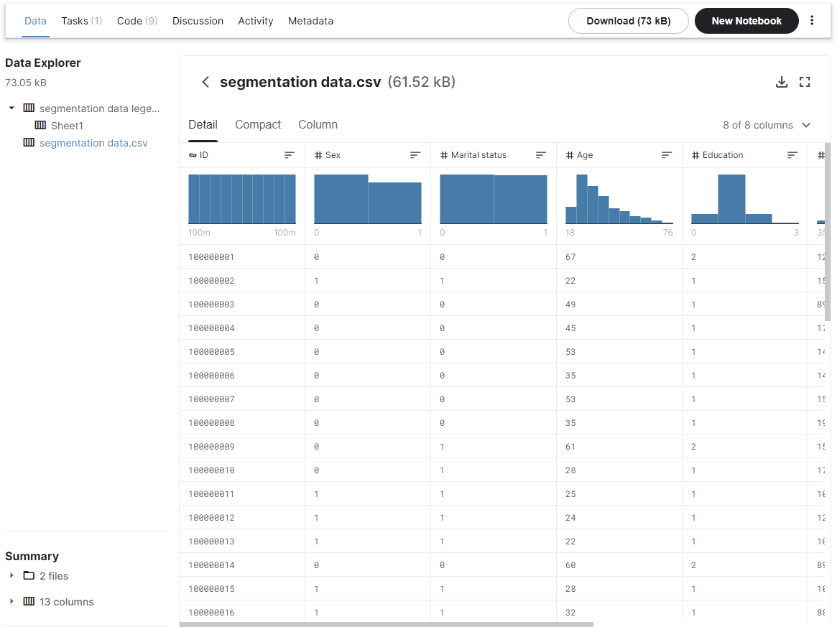
Data Collection
I started looking for a dataset that had demographic data and included income.
My search led me to many different sites but I decided to use a dataset that I found on Kaggle.
Click HERE to view the data on the site.

Slide 5
Data Collection Rational
I found this data really appealing because it seemed pretty clean overall. Looking at the data detail in Kaggle I could see that the data did not appear to have Null or NA values. It also looked liked a good sample size and had some of the dimensions I was looking for like education, sex, marital status, etc.
The one risk that I will callout is that the income was self-reported. This could interne mean there is some bias or error in this dataset as a result.

Slide 6
Data Dictionary
Variable | Data Type | Range | Description | Values
ID | Numerical | 1 – 2000 | Unique ID
Sex | Categorical | (0,1) | Biological sex of individual | 0 = male 1 = female
Marital Status | Categorical | (0,1) | Marital Status | 0 = single 1 = non-single
Age | Numerical | Min = 18 Max = 76 | Age of individual in years
Education | Categorical | (0,1,2,3) | Level of education | 0 = unknown / other 1= high school 2 = university 3 = graduate school
Income | Numerical | Min = 35,832 Max = 309,364 | Self-reported Income
Occupation | Categorical | (0,1,2) | Category of occupation | 0 = unskilled 1 = skilled 2 = management
Settlement Size | Categorical | (0,1,2) | Size of the city the individual lives | 0 = small city 1 = mid-sized city 2 = big city

Slide 7
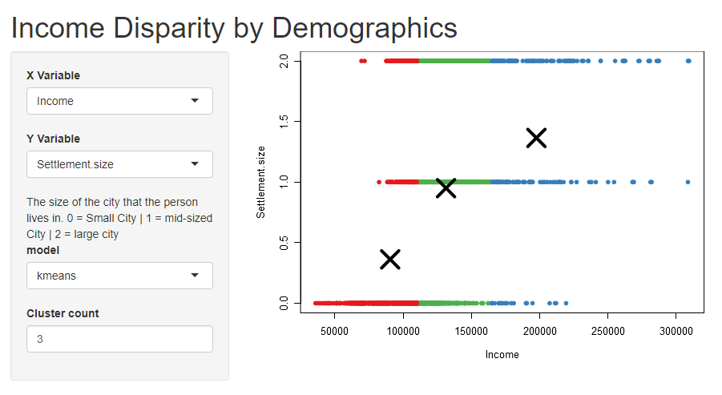
Shiny App User Guide

Slide 8
Shiny App User Guide
Main Header
Selected Y
Variable
Visual of
Selected Model
Dynamic data
dictionary
Selected Model
# of clusters

Slide 9
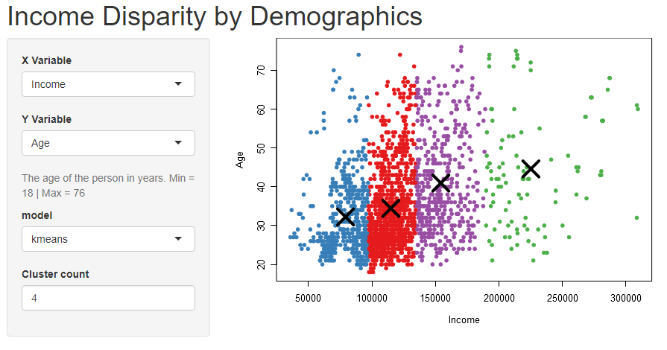
Shiny App User Guide
Main Header
Selected Age
Visual updated
based on
selections
Dynamic text
updated
Chose 4
clusters

Slide 10

Requirements Checklist
Give the users three visuals to view the data in different ways
Allow the users to choose the number of clusters when using a clustering method
Allow the users to choose between different variables
Add a dynamic data dictionary that updates when selecting different variables
The chosen visuals must be easy to understand and intuitive

Slide 11
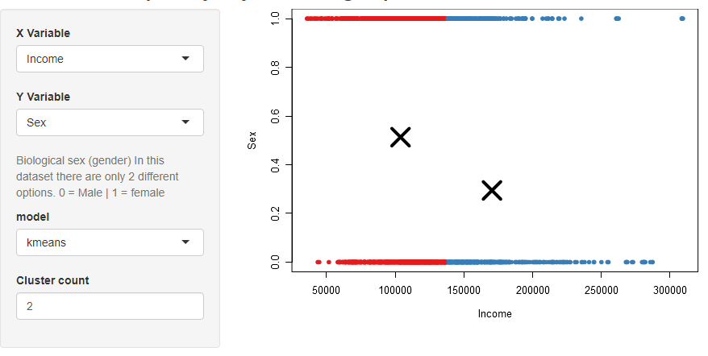
Interesting Insights
Men make more income than women on average
When comparing income vs sex and using two clusters we can see that the red cluster which would represent low to middle class income averages about 50 / 50 between male and female.
However; when looking at the blue cluster which represents higher income levels we can see its about a 25 / 75 with more males making it into that cluster.

Slide 12
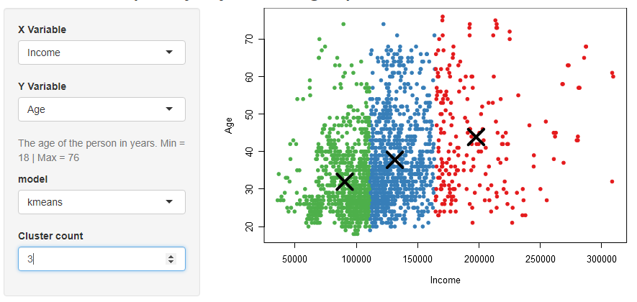
Interesting Insights Continued
People make more money as they get older
When looking at income vs age and using 3 clusters we can see that the green cluster which makes up incomes from the min value to about $110,000 averages at about 31 years old. The blue cluster with incomes from about $110,000 to $160,000 has an average age of about 39. Last the red cluster which as incomes from about $160,000 to the max value has an average age of about 45.

Slide 13
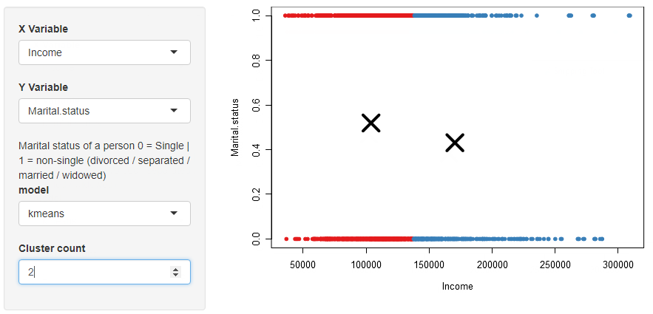
Interesting Insights Continued
Single people make more on than non-single marital statuses
When comparing income vs marital status and using 2 clusters we can see that the first cluster which makes up low to middle class income is about an even split between single and non-single statuses.
However; the higher incomes lean more toward a single status.

